Slide 1

Database Processing: Fundamentals, Design, and Implementation
15th Edition
Week #4
Part 2A
Introduction to Structured Query Language

Slide 2
Querying Two or More Tables with SQL
SQL provides two different techniques for querying data from multiple tables:
The SQL subquery
The SQL join
Although both work with multiple tables, they are used for slightly different purposes.

Slide 3

Querying Multiple Tables with SQL Subqueries (1 of 5) The Logic of Subqueries
We want to know the revenue for Water Sports items, which have SKU values of 100100, 100200, 101100, and 101200.
Given that we know the SKU values, we can use this query:
SELECT SUM(ExtendedPrice) AS WaterSportsRevenue
FROM ORDER_ITEM
WHERE SKU IN (100100, 100200, 100300, 100400, 100500, 100600, 101100, 101200);

Slide 4
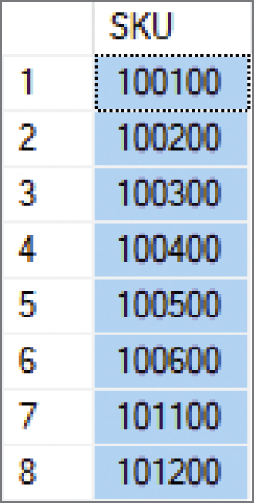
Querying Multiple Tables with SQL Subqueries (2 of 5) The Logic of Subqueries
What if we don’t know the SKU values? We can determine them with this query:
SELECT SKU
FROM SKU_DATA
WHERE Department = 'Water Sports';

Slide 5

Querying Multiple Tables with SQL Subqueries (3 of 5) The Logic of Subqueries
We can combine these two as shown below. The second query, which is enclosed in parentheses, is called an SQL subquery. Note how the subquery returns a set of values for use by the top level query, and note the use of the SQL IN keyword.
SELECT SUM(ExtendedPrice) AS WaterSportsRevenue
FROM ORDER_ITEM
WHERE SKU IN
(SELECT SKU
FROM SKU_DATA
WHERE Department = 'Water Sports');

Slide 6
Querying Multiple Tables with SQL Subqueries (4 of 5) The Logic of Subqueries
An SQL subquery is often described as:
A nested query
A query within a query
Note that SQL queries using subqueries are still effectively single table queries in the sense that only the columns of the top level query can be displayed in the query results!
Multiple subqueries can be used to process three or even more tables.
All parts if the SQL SELECT statement syntax can be applied to the table displaying the results of an SQL query using subqueries.

Slide 7
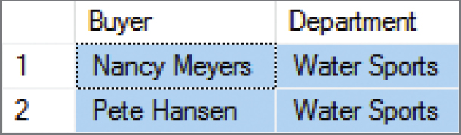
Querying Multiple Tables with SQL Subqueries (5 of 5) The Logic of Subqueries
SELECT DISTINCT Buyer, Department
FROM SKU_DATA
WHERE SKU IN
(SELECT SKU
FROM ORDER_ITEM
WHERE OrderNumber IN
(SELECT OrderNumber
FROM RETAIL_ORDER
WHERE OrderMonth = 'January’
AND OrderYear = 2018));

Slide 8
Querying Multiple Tables with SQL Joins (1 of 10) The Logic of Joins
In an SQL join operation, the SQL JOIN operator is used to combine parts or all of two or more tables.
Explicit join ─ the SQL JOIN operator is used as part of the SQL statement.
Implicit join ─ the SQL JOIN operator is not used as part of the SQL statement.

Slide 9
Querying Multiple Tables with SQL Joins (2 of 10) SQL CROSS JOIN
An SQL CROSS JOIN combines each row in one table with every row in another table.
SELECT *
FROM RETAIL_ORDER, ORDER_ITEM;
This is known mathematically as a Cartesian product of the rows in the tables.
This is illogical in database work because we only need rows that somehow logically correspond in the two tables.

Slide 10
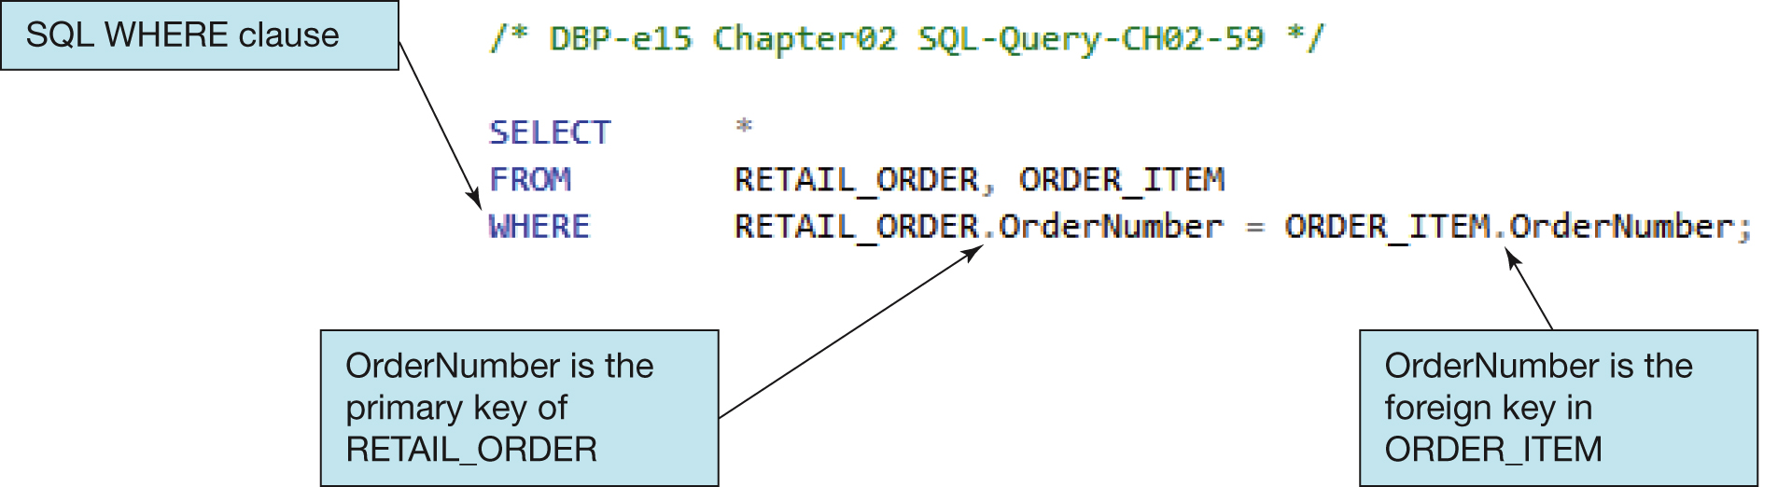
Querying Multiple Tables with SQL Joins (3 of 10) Implicit SQL INNER JOIN
By selecting rows by matching by the primary key values of one table with the foreign key values of a second table, we produce an SQL INNER JOIN.
Because the SQL JOIN keyword does not appear in the SQL statement, this is an implicit join.

Slide 11
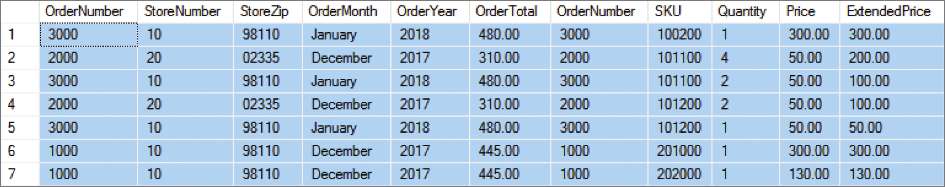
Querying Multiple Tables with SQL Joins (4 of 10) Implicit SQL INNER JOIN
SELECT *
FROM RETAIL_ORDER, ORDER_ITEM
WHERE RETAIL_ORDER.OrderNumber = ORDER_ITEM.OrderNumber;

Slide 12
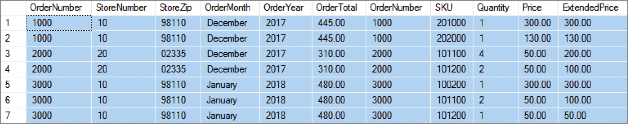
Querying Multiple Tables with SQL Joins (5 of 10) Implicit SQL INNER JOIN
With an SQL ORDER BY clause for easier reading by OrderNumber:
SELECT *
FROM RETAIL_ORDER, ORDER_ITEM
WHERE RETAIL_ORDER.OrderNumber = ORDER_ITEM.OrderNumber ORDER BY RETAIL_ORDER.OrderNumber, ORDER_ITEM.SKU;

Slide 13
Querying Multiple Tables with SQL Joins (6 of 10) EQUIJOIN
The process of using an SQL JOIN operation to join two tables is called joining the two tables.
When tables are joined using an equal to condition as in the example above, the join is called an equijoin.
When people say “join,” 99.99999 percent of the time they mean equijoin.
Multiple joins can be used to process three or even more tables.
All parts of the SQL SELECT statement syntax can be applied to the table displaying the results of an SQL query using joins.

Slide 14
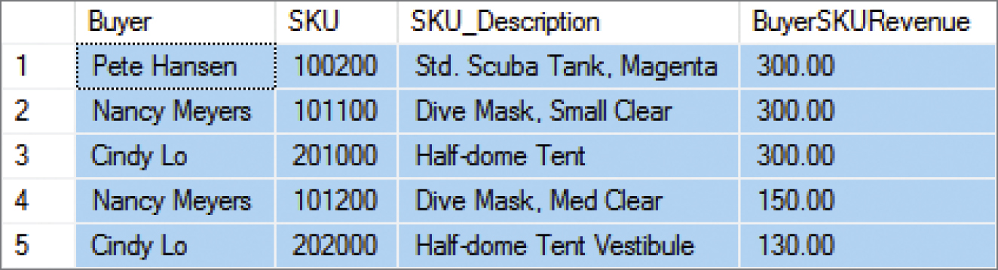
Querying Multiple Tables with SQL Joins (7 of 10) The Logic of Joins
SELECT Buyer, SKU_DATA.SKU, SKU_Description,
SUM(ExtendedPrice) AS BuyerSKURevenue
FROM SKU_DATA, ORDER_ITEM
WHERE SKU_DATA.SKU = ORDER_ITEM.SKU
GROUP BY Buyer, SKU_DATA.SKU, SKU_Description
ORDER BY BuyerSKURevenue DESC;

Slide 15
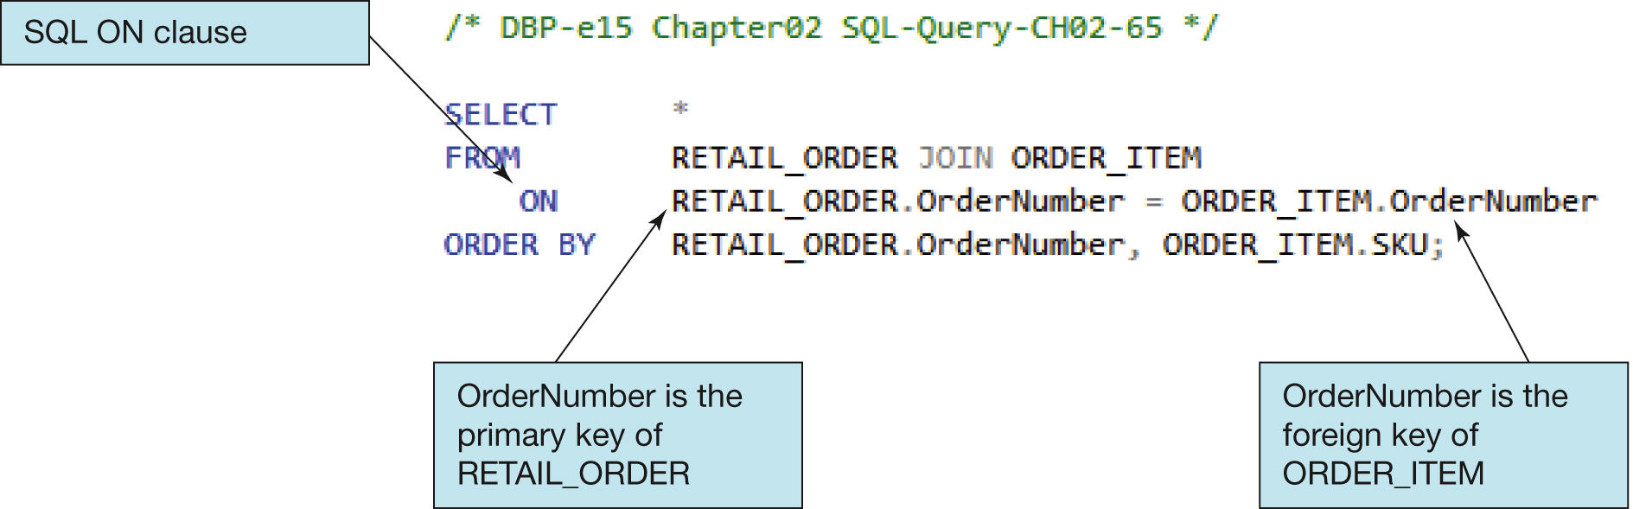
Querying Multiple Tables with SQL Joins (8 of 10) Explicit SQL INNER JOIN
Selecting rows by matching by the primary key values of one table with the foreign key values of a second table, we produce an SQL INNER JOIN.
Because the SQL JOIN keyword does appear in the SQL statement, this is an explicit join.

Slide 16
Querying Multiple Tables with SQL Joins (9 of 10) SQL JOIN ON Syntax
In SQL JOIN ON syntax:
The SQL JOIN keyword is placed between the table names in the SQL FROM clause, where it replaces the comma that previously separated the two table names.
The SQL ON keyword now leads into an SQL ON clause, which includes the statement of matching key values that was previously in an SQL WHERE clause.
The SQL WHERE clause is no longer used as part of the join, which makes it easier to read the actual restrictions on the rows in the query in the SQL WHERE clause itself.
The explicit SQL JOIN ON syntax is currently considered as the proper way to write SQL join operations, and the older implicit SQL syntax is considered an archaic, older syntax (but it still works).

Slide 17
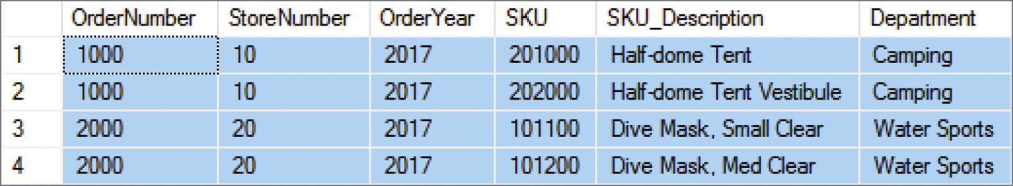
Querying Multiple Tables with SQL Joins (10 of 10) The Logic of Joins
SELECT *
FROM RETAIL_ORDER JOIN ORDER_ITEM
ON RETAIL_ORDER.OrderNumber = ORDER_ITEM.OrderNumber WHERE OrderYear = 2017
ORDER BY RETAIL_ORDER.OrderNumber, ORDER_ITEM.SKU;

Slide 18
Database Processing Fundamentals, Design, and Implementation (15th Edition)
End of Presentation:
Week #4
Part 2A

